Slide 1
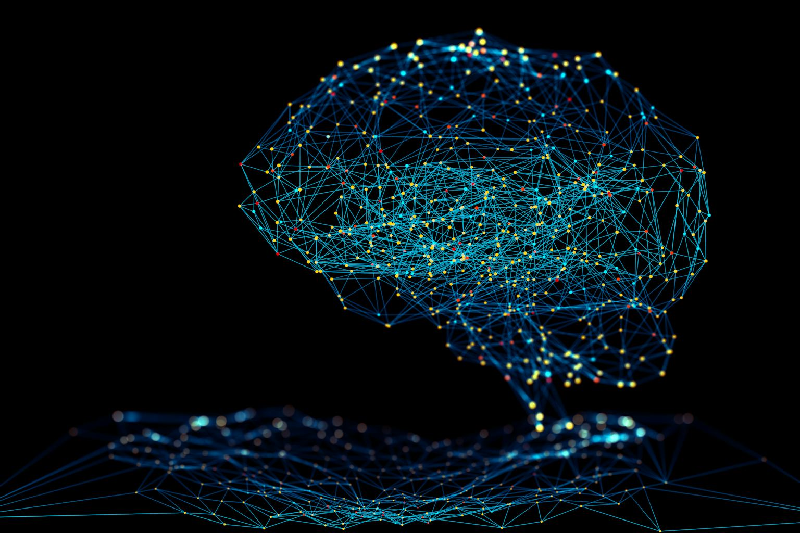
Image Classifier
Real vs AI with Neural Networks
SPRINGBOARD
CAPSTONE
3
Jason C. Jiang

Slide 2
A Little Background
Recent years have seen the dramatics rise of AI, becoming the buzzword of the tech industry
Our company is a software startup focused on computer vision
The rapid ascent of AI also brings many risks associated with it
Multiple clients approached us each asking for some kind of image recognition model
Notes:
In recent years, with the rise of generative Artificial Intelligence, more and more content that is being created originated from these generative AI models such as Chat-GPT, DALL-E, Veo, etc. While this opens the door to many more people to pursue content generation and verification, whether it is for marketing, learning, or simply for entertainment, this also comes at the cost of controversy surrounding ethics, trust, security, and commercialization. What if the difference between a real image versus an AI generated one becomes crucial.
Multiple potential clients have approached the company asking for a product.

Slide 3
LIST OF CLIENTS AND DEMANDS
Client | Product of Interest
Generic Media Corp. A | A model to determine if an image is real or not when writing and publishing news articles
Investigative Firm B | A model to determine if images used in court cases are real or not
Fintech Startup C | A model to classify if an uploaded user ID photo is real or fake
Online Dating App D | A model to determine if an uploaded profile photo is real or not
The Federal Government | A model to determine if images of people’s faces are real or fake

Slide 4

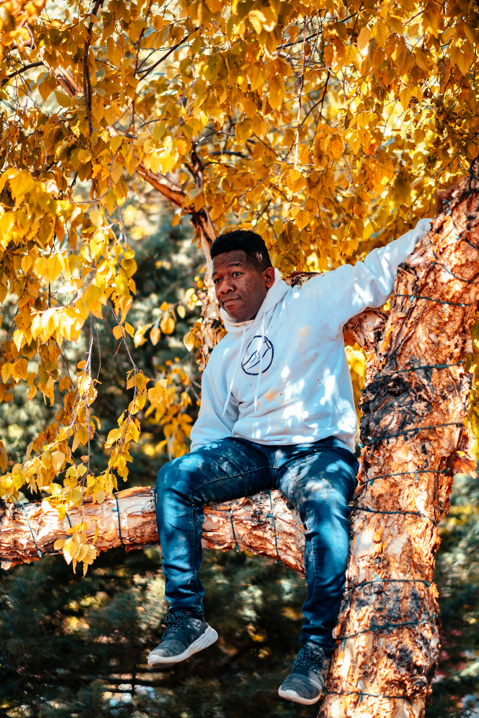
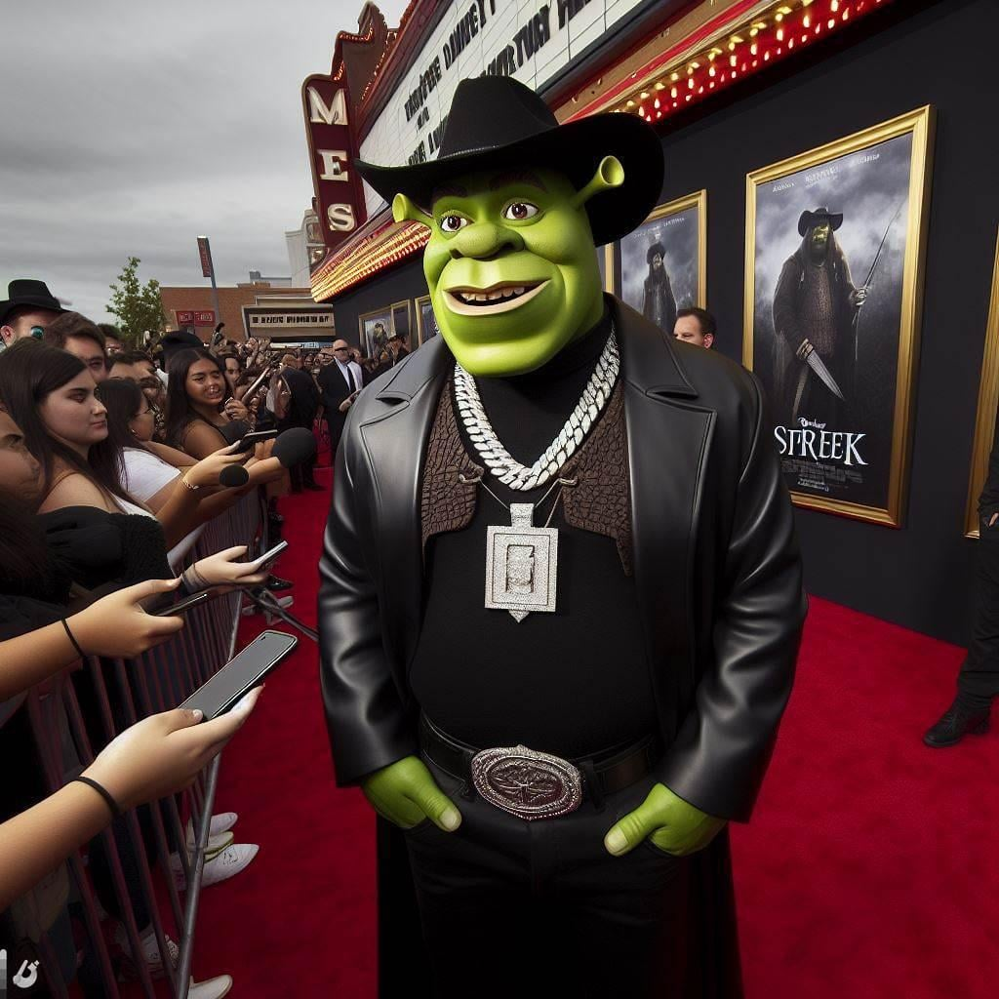
What’s the Solution?
Build a generalized model that can classify an image as either real or fake/AI generated

Slide 5



Proposed Model: A Neural Network
INSPIRED BY THE HUMAN BRAIN
1
2
3
It consists of interconnected layers of nodes (neurons) that process data by adjusting connection strengths (weights) through training
DEEP LEARNING
ACTIVATION
OPTIMIZATION
Many hidden layers
Function to learn patterns
Update weights via gradient descent
DETAILS
Notes:
Deep learning refers to neural networks with many hidden layers, enabling them to learn complex, hierarchical representations (e.g., edges → shapes → objects in images)
Data flows from input → hidden layers → output
Each neuron applies a weighted sum and nonlinear function (activation) to learn patterns
Training uses optimization (like gradient descent) to reduce error by updating weights

Slide 6
Why?
Only 1 Model?
Why does it have to be a generalized network?
Notes:
Now you may ask why are we building a generalized network when all of our clients want a neural network for a more specific task. By building a generalized one, aren’t we creating a compromise that ends up solving nothing?

Slide 7
TRANSFER LEARNING

Slide 8
TRANSFER LEARNING
EASE OF TRAINING
COST EFFICIENT
ONE MODEL FOR ALL
GOOD FOR SCALING
Allows an existing model already trained to be re-trained for a similar task without needing to build a new model
Training only one model is much cheaper and faster than doing multiple models for each client
By doing minimal tweaking of the base model, it can be used to do plenty of image classification tasks
Updating the base model means all its specialized varients can be updated all at once effectively

Slide 9
OBJECTIVE:
Construct an Image Classifier
Determine if an image is real or AI generated

Slide 10
THE DATASET
60,000 Images
All images are in the form of .jpg or .png files
30,000 Real, 30,000 Fake
Real images had a human origin, fake ones from generative AI
Pre-split into training and testing datasets
80% were in the training folder, 20% in the testing folder
File Structure:
Train Fake <Images>
Real <Images>
Test Fake <Images>
Real <Images>

Slide 11




The Data Science Method
Collect and clean the dataset
DATA WRANGLING
Understand relationships within the data
EDA
PROBLEM IDENTIFIED
Standardize and train the dataset
DATA PREPROCESSING
Select, train, and deploy the model
MODELING

Slide 12

DATA WRANGLING
Image Dataset Already Organized
1
No further cleaning was necessary

Slide 13

The Data Science Method
Collect and clean the dataset
DATA WRANGLING
Understand relationships within the data
EDA
PROBLEM IDENTIFIED
Standardize and train the dataset
DATA PREPROCESSING
Select, train, and deploy the model
MODELING

Slide 14
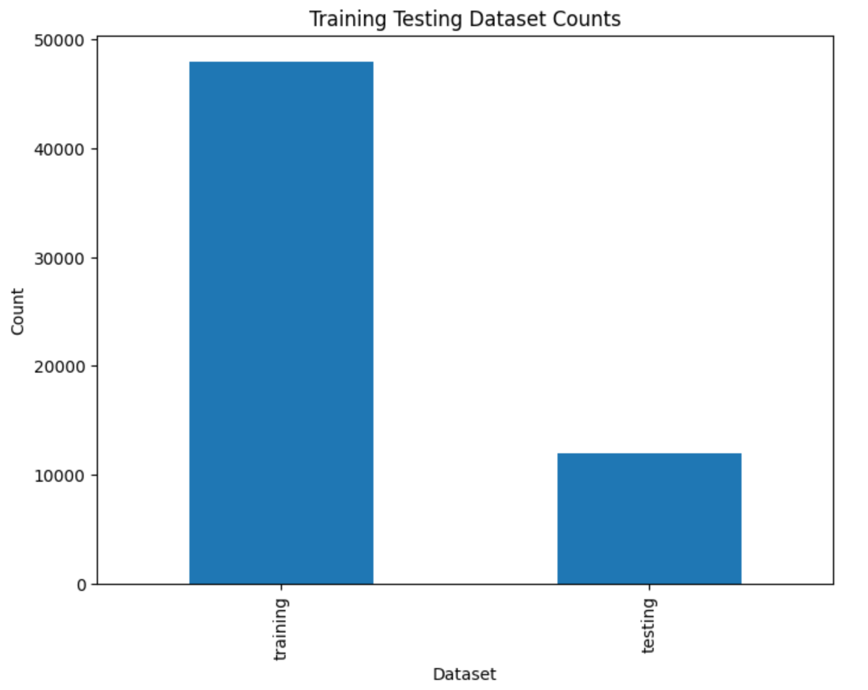
EXPLORATORY DATA ANALYSIS
IMAGE DISTRIBUTION
DOWNSIZE IMAGES TO 128x128
DOWNSIZE IMAGES TO 224x224 variant
1
Checked for image properties and distributions across train/test and fake/real labels
2
Downsized all 60,000 images to 128x128 to avoid using up too much memory/slowing down training
3
Created a 224x224 downsized image collection as a compromise between 128x128 and the original sizes

Slide 15

The Data Science Method
Collect and clean the dataset
DATA WRANGLING
Understand relationships within the data
EDA
PROBLEM IDENTIFIED
Standardize and train the dataset
DATA PREPROCESSING
Select, train, and deploy the model
MODELING

Slide 16
DATA PREPROCESSING
Fake
Images
Train 128
Real
Images
Fake
Images
Test 128
Real
Images
Dataset
Fake
Images
Train 224
Real
Images
Fake
Images
Test 224
Real
Images
Notes:
The main change in data preprocessing was changing up the file paths of all the images, this way they were easier to feed into the models for training. Another key note is that for the 224x224 images, not all 60,000 of them will eventually be used, as to make sure the models do not take forever to train, only about a sample size of 9,000 was taken.

Slide 17

The Data Science Method
Collect and clean the dataset
DATA WRANGLING
Understand relationships within the data
EDA
PROBLEM IDENTIFIED
Standardize and train the dataset
DATA PREPROCESSING
Select, train, and deploy the model
MODELING

Slide 18
MODELING
1
3
5
CNN 128x128
ResNet-50
ConvNextBase
A convolutional neural network trained on the 128x128 image dataset
Transfer learning from the existing model onto the 224x224 image dataset
Existing large vision model trained onto the 224x224 image dataset
2
4
CNN 224x224
EfficientNetV2-B0
A convolutional neural network trained on the 224x224 image dataset
Transfer learning from the existing model onto the 224x224 image dataset

Slide 19
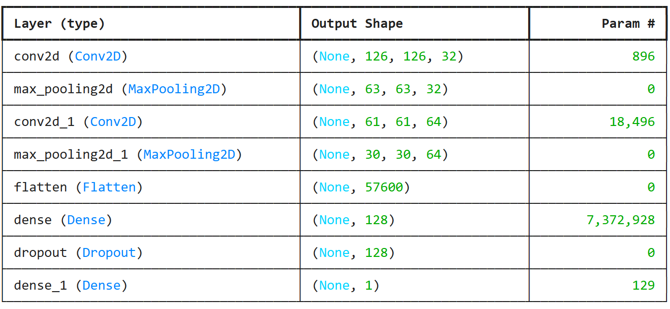
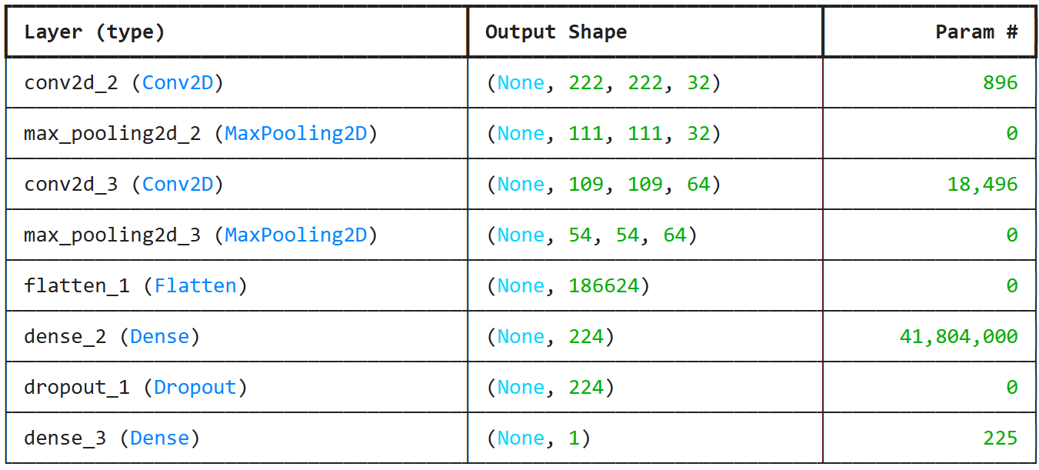
MORE MODELING
CNN 128
CNN 224
8 layers
2 sets of convolution and pooling
8 layers
2 sets of convolution and pooling

Slide 20
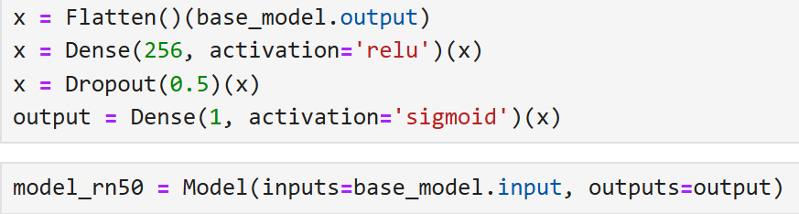
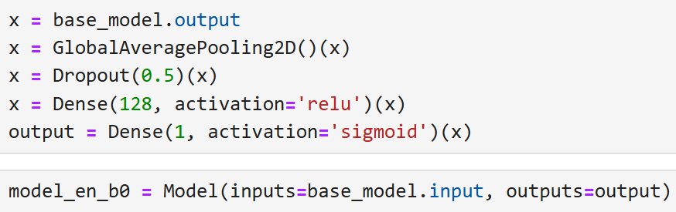
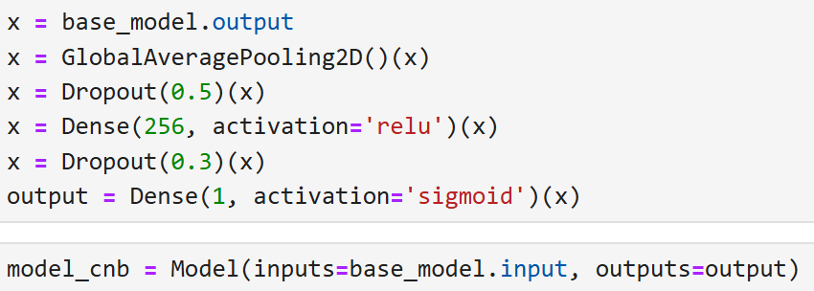
ResNet-50
EfficientNetV2-B0
ConvNeXtBase
179 layers
Key feature is skip connections
274 layers
Uniformly scales all dimensions
300 layers
Combines CNNs with Vision Transformers

Slide 21

The Data Science Method
Collect and clean the dataset
DATA WRANGLING
Understand relationships within the data
EDA
PROBLEM IDENTIFIED
Standardize and train the dataset
DATA PREPROCESSING
Select, train, and deploy the model
MODELING

Slide 22
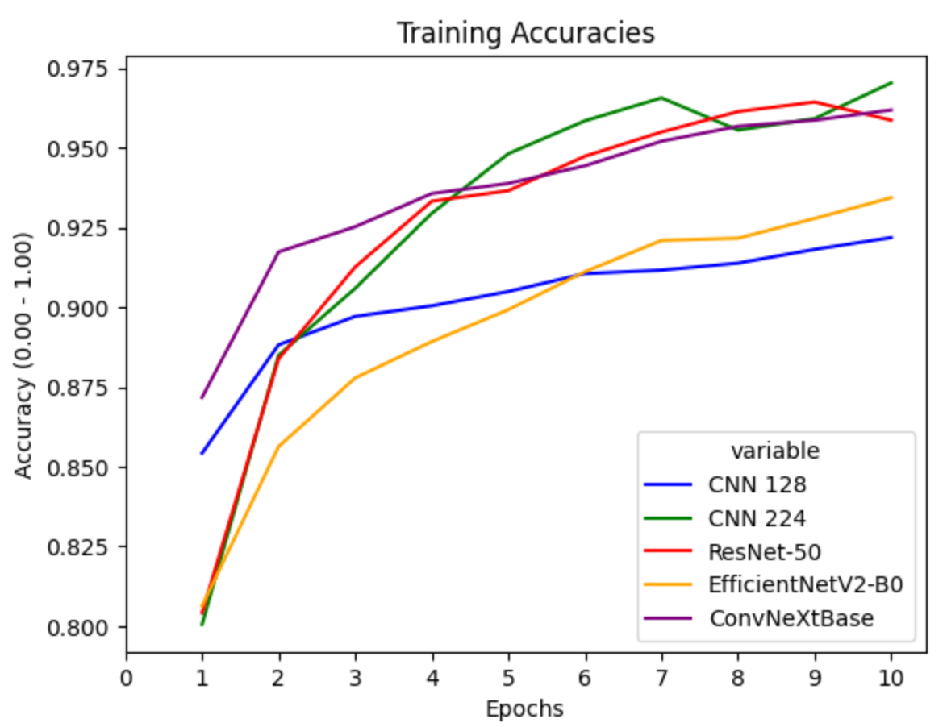
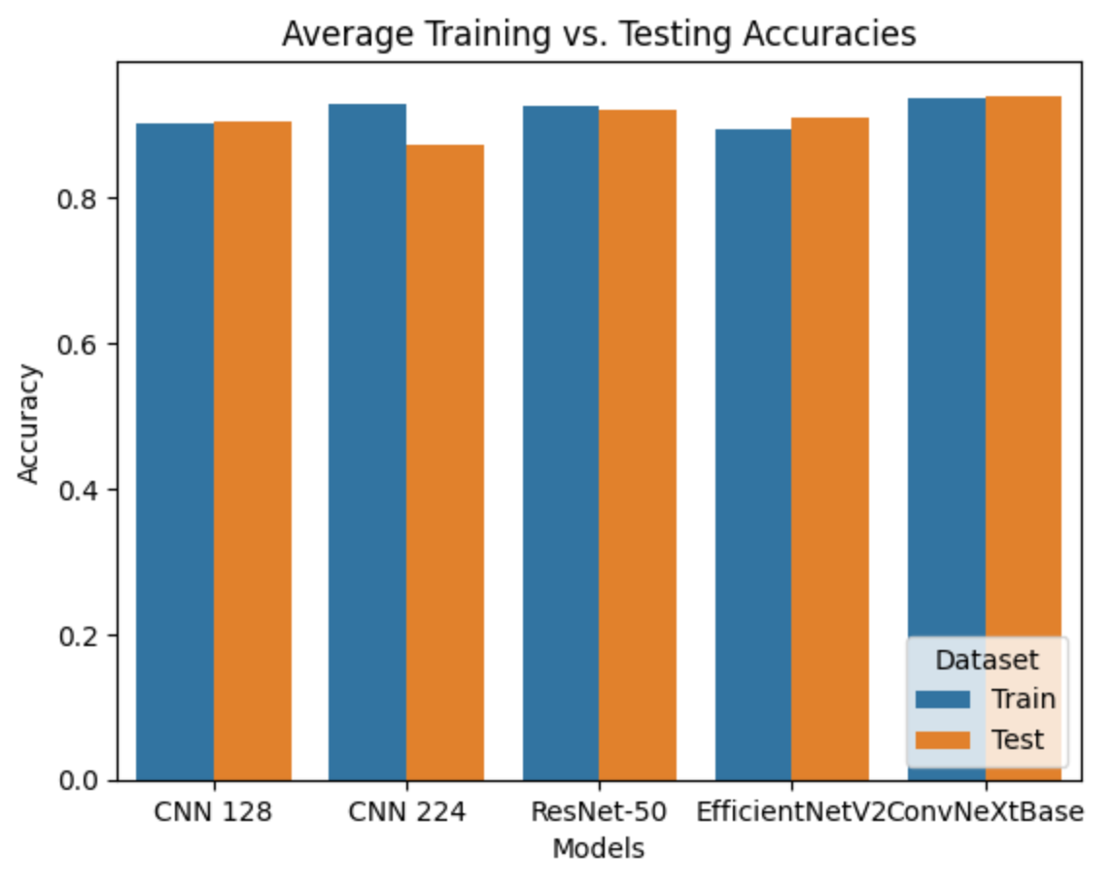
Training Accuracies
Training vs. Testing
Comparison across the candidate models
Accuracy comparison between training and testing datasets across the models

Slide 23
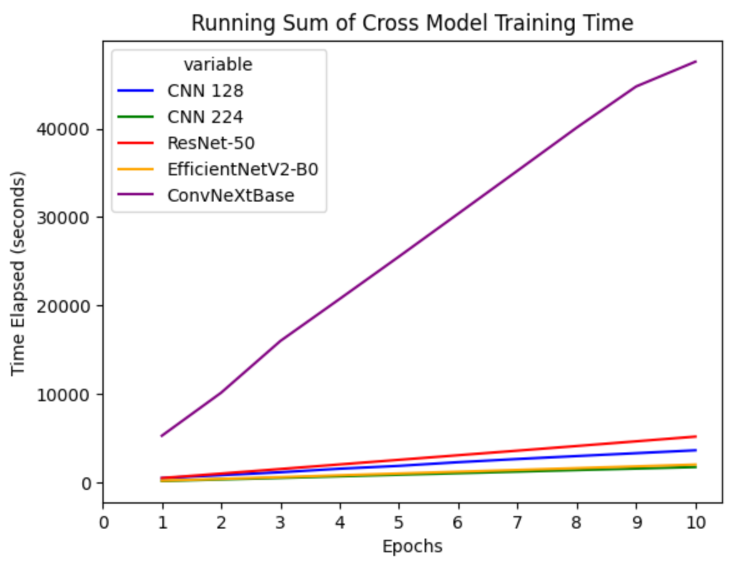
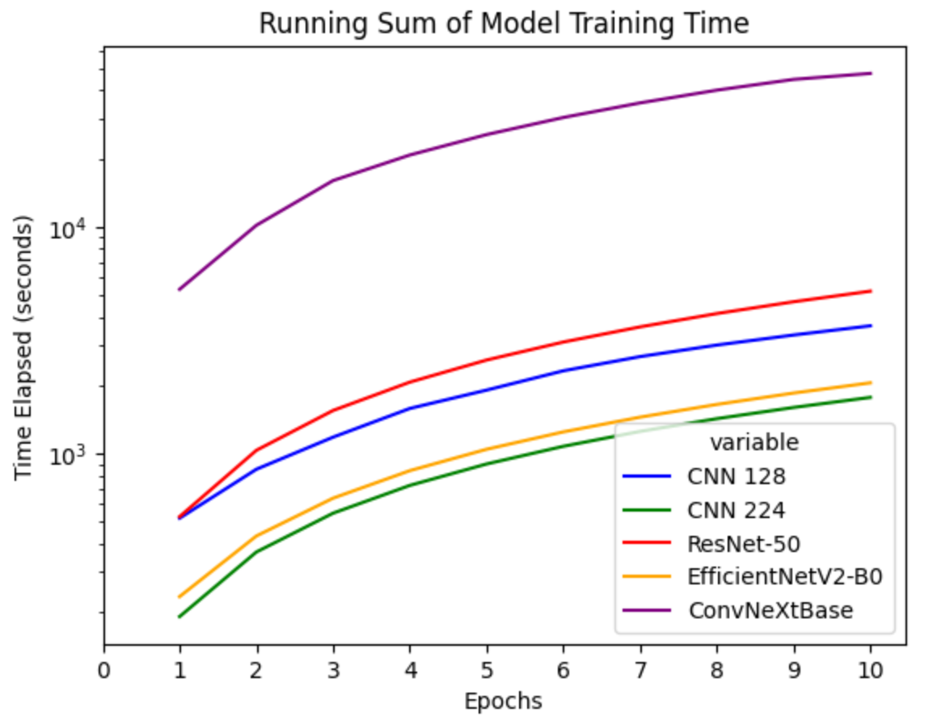
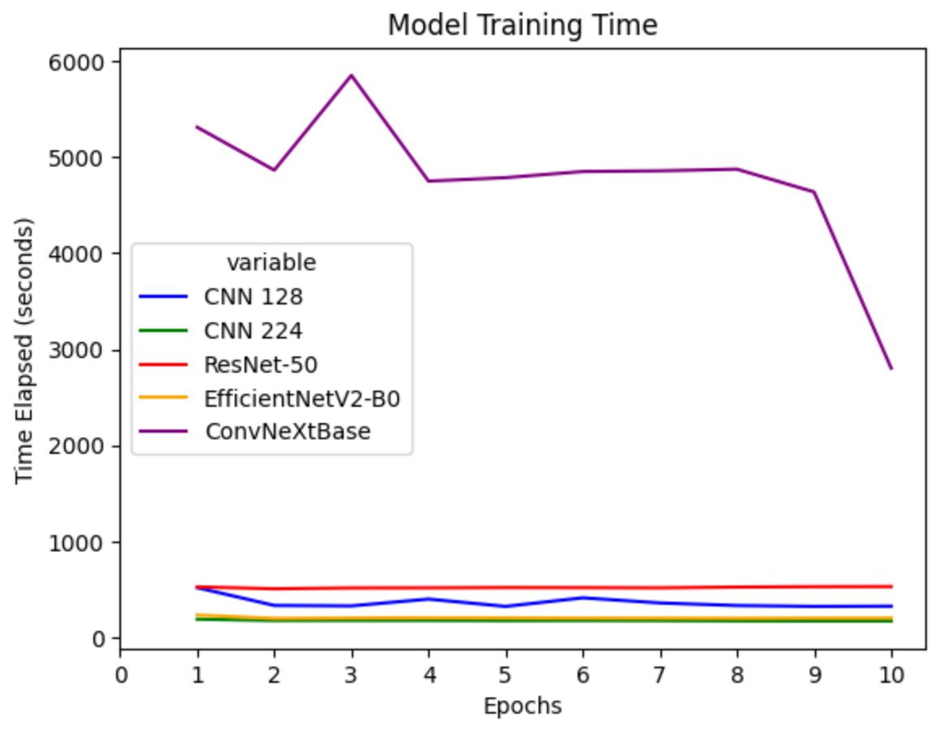
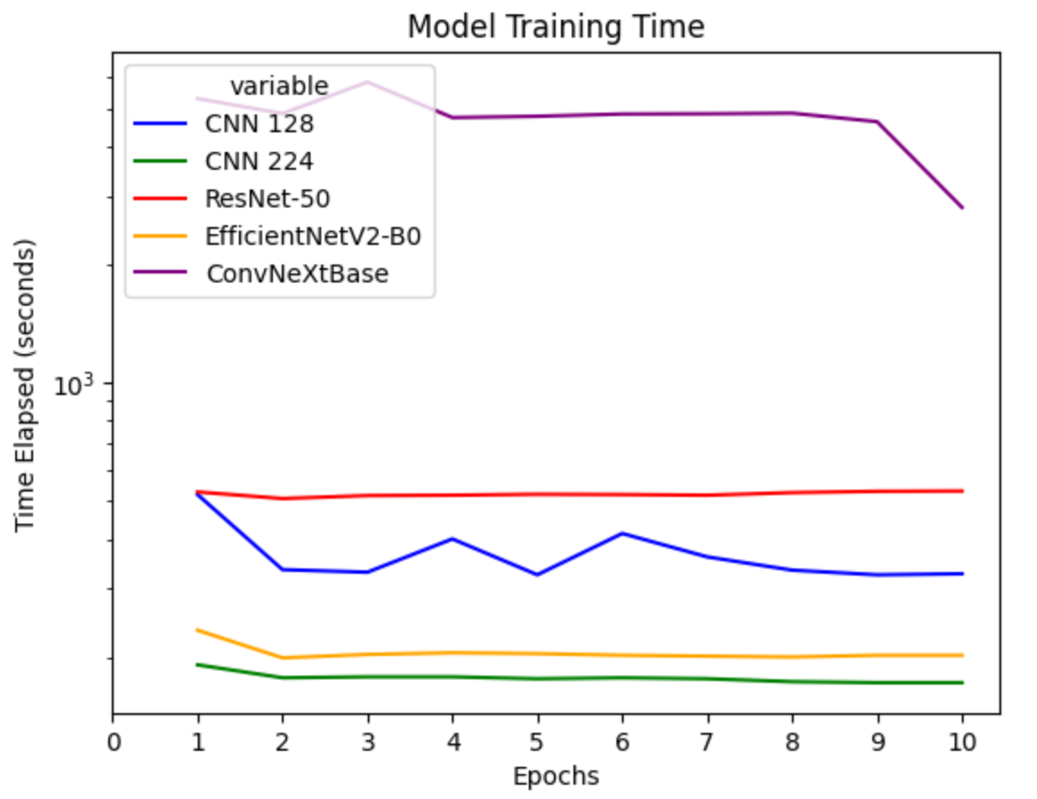
Model Training Time
Cumulative Model Training Time
Time taken to train each model (normal vs. logarithmic graph)
Cumulative time taken to train each model (normal vs. logarithmic graph)

Slide 24
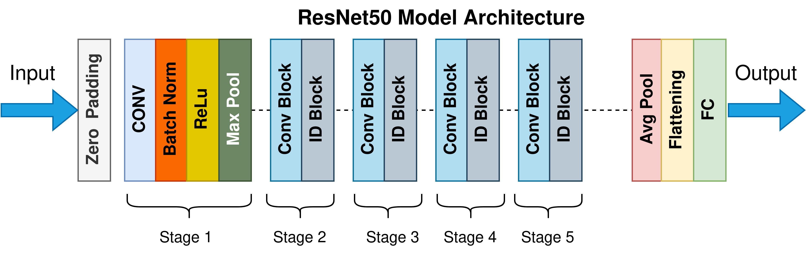
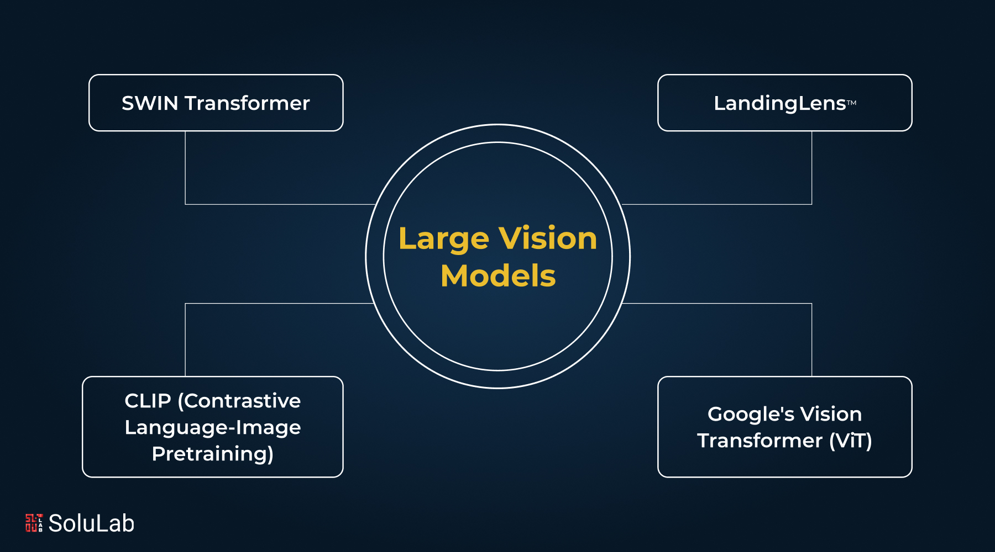
SELECTED NEURAL NETWORKS
ResNet-50
Popular and effective Convolutional neural network (CNN)
ConvNeXtBase
A CNN integrated with elements from Vision Transformers (large vision model)

Slide 25
THE SELECTED MODELS DETAILED
MODEL A – RESNET
MODEL B – CONVNEXT
Well known and reliable CNN
50 layers, with skip connections
Easy to implement for transfer learning
tensorflow.keras
Strong accuracy and decent training time
Combines CNNs with Vision Transformers (ViT), a type of large vision model
CNN part based off of Resnet
Can also be implemented from tensorflow.keras
More accurate than Resnet
Requires a strong GPU for good training time

Slide 26

TOPICS FOR THE FUTURE
Experiment with GPU usage in terms of improving training time
Using large vision models can be greatly beneficial as the dataset grows larger and larger.
Classification beyond real vs AI (such as dog or cat on top of real vs AI)

Slide 27
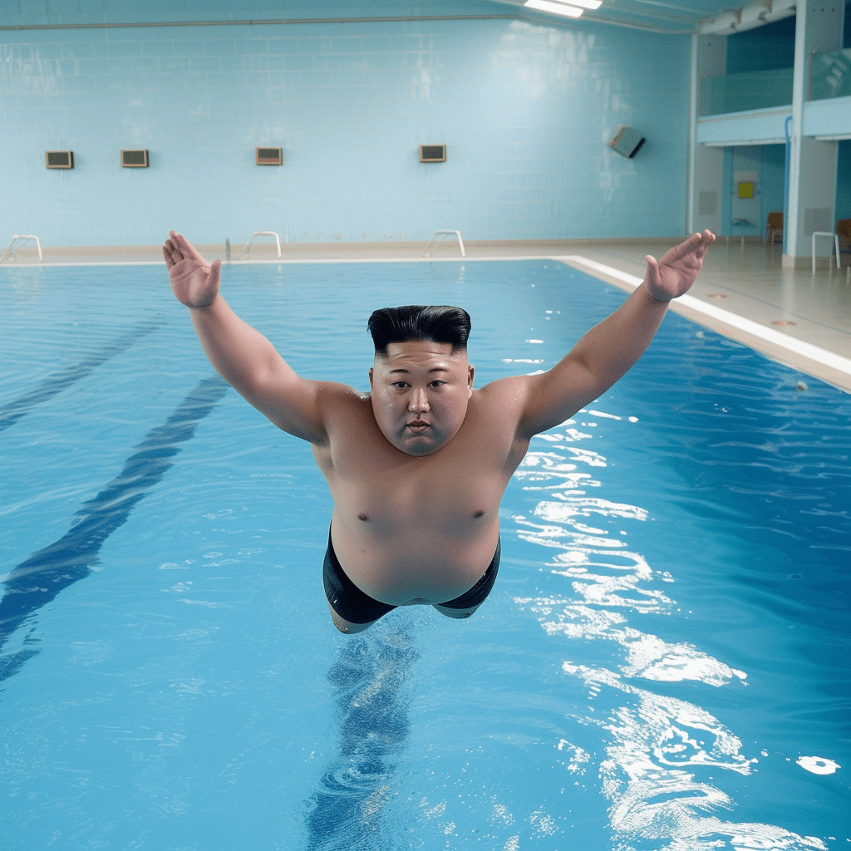
THANKS!
DO YOU HAVE ANY QUESTIONS?
tankstar03@hotmail.com
+1 973 738 7520
github.com/Tankstar03/
Please keep this slide for attribution

Slide 28








ALTERNATIVE RESOURCES
Here’s an assortment of alternative resources whose style fits the one of this template:
VECTORS:
Instagram stories collection for artificial intelligence science

Slide 29
RESOURCES
Did you like the resources on this template? Get them for free at our other websites.
VECTORS
Artificial intelligence landing page
Artificial intelligence banner
Artificial intelligence banner template
PHOTOS
Descomposition of person wearing vr glasses
Metaverse concept collage design I
Metaverse concept collage design II
Front view of woman using virtual reality headset

Slide 30
Instructions for use
If you have a free account, in order to use this template, you must credit Slidesgo by keeping the Thanks slide. Please refer to the next slide to read the instructions for premium users.
As a Free user, you are allowed to:
- Modify this template.
- Use it for both personal and commercial projects.
You are not allowed to:
- Sublicense, sell or rent any of Slidesgo Content (or a modified version of Slidesgo Content).
- Distribute Slidesgo Content unless it has been expressly authorized by Slidesgo.
- Include Slidesgo Content in an online or offline database or file.
- Offer Slidesgo templates (or modified versions of Slidesgo templates) for download.
- Acquire the copyright of Slidesgo Content.
For more information about editing slides, please read our FAQs or visit Slidesgo School:
https://slidesgo.com/faqs and https://slidesgo.com/slidesgo-school

Slide 31
Instructions for use (premium users)
As a Premium user, you can use this template without attributing Slidesgo or keeping the "Thanks" slide.
You are allowed to:
Modify this template.
Use it for both personal and commercial purposes.
Hide or delete the “Thanks” slide and the mention to Slidesgo in the credits.
Share this template in an editable format with people who are not part of your team.
You are not allowed to:
Sublicense, sell or rent this Slidesgo Template (or a modified version of this Slidesgo Template).
Distribute this Slidesgo Template (or a modified version of this Slidesgo Template) or include it in a database or in any other product or service that offers downloadable images, icons or presentations that may be subject to distribution or resale.
Use any of the elements that are part of this Slidesgo Template in an isolated and separated way from this Template.
Register any of the elements that are part of this template as a trademark or logo, or register it as a work in an intellectual property registry or similar.
For more information about editing slides, please read our FAQs or visit Slidesgo School:
https://slidesgo.com/faqs and https://slidesgo.com/slidesgo-school

Slide 32
Fonts & colors used
This presentation has been made using the following fonts:
Play
(https://fonts.google.com/specimen/Play)
Source Sans Pro
(https://fonts.google.com/specimen/Source+Sans+Pro)
#181921
#ffffffff
#120369
#6fa2ce
#ff0000

Slide 33

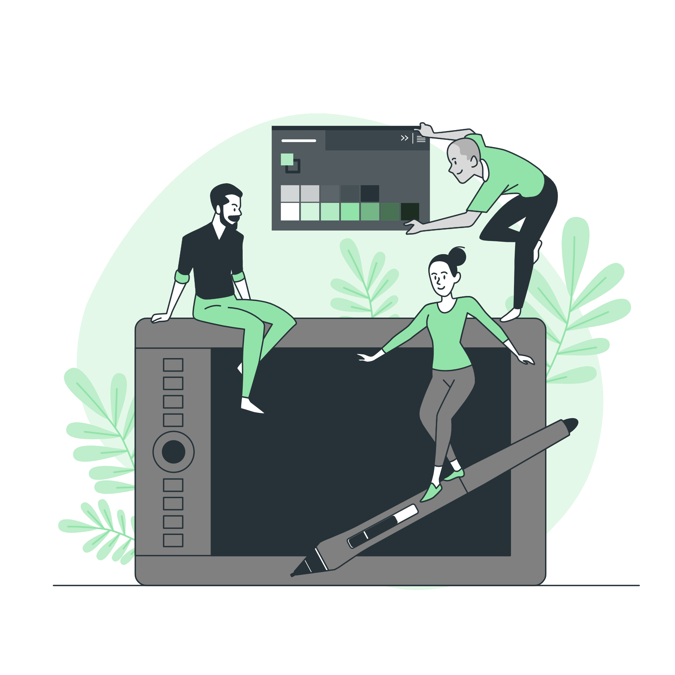



Storyset
Create your Story with our illustrated concepts. Choose the style you like the most, edit its colors, pick the background and layers you want to show and bring them to life with the animator panel! It will boost your presentation. Check out how it works.
Pana
Amico
Bro
Rafiki
Cuate

Slide 34
Use our editable graphic resources...
You can easily resize these resources without losing quality. To change the color, just ungroup the resource and click on the object you want to change. Then, click on the paint bucket and select the color you want. Group the resource again when you’re done. You can also look for more infographics on Slidesgo.

Slide 37
JANUARY
FEBRUARY
MARCH
APRIL
MAY
JUNE
PHASE 1
Task 1
Task 2
PHASE 2
Task 1
Task 2
JANUARY
FEBRUARY
MARCH
APRIL
PHASE 1
Task 1
Task 2

Slide 40


